Slide 1

Job Seeker
L03 G03

Slide 2
Motivation
Background: Job search is a timeless demand for human society. The prospect of the market is bright since job search tool becomes more and more significant in modern life.
The advantages of the job search tool market:
more popular than traditional methods
huge demand
sustaining potential

Slide 3
Problem
Users expect more information than current tools commonly provide. For example:
potential of the job and the field
the demands for such job in different locations.

Slide 4
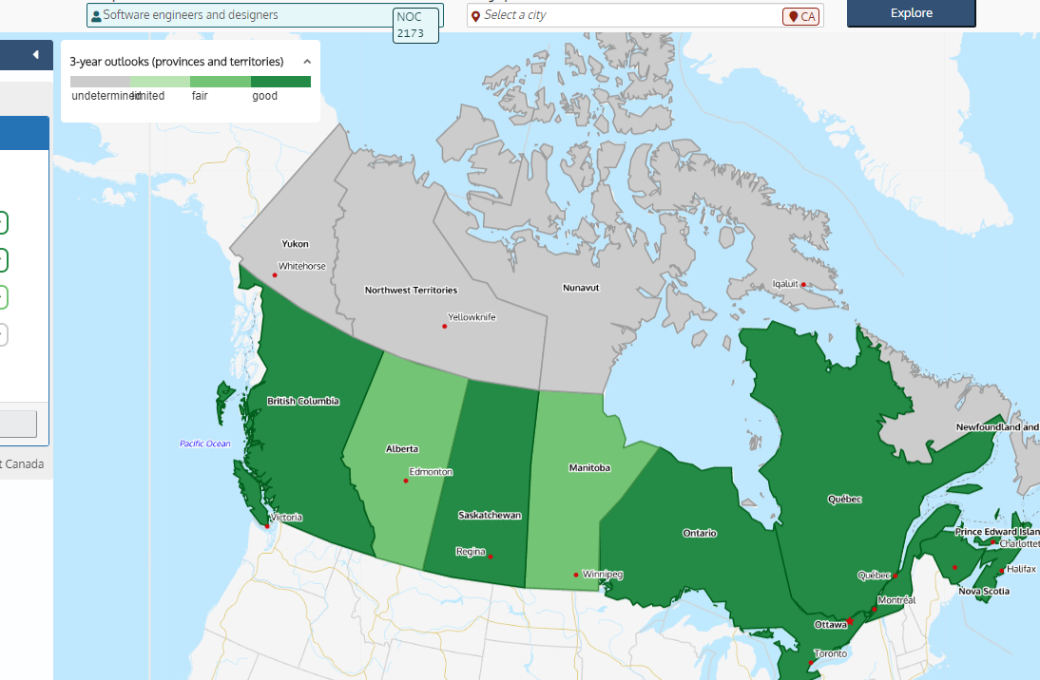

Prior Work
Job bank
Shows spatial distribution
No visualization of data over recent years
Indeed.com
Focuses more on posting and hiring of particular job openings with detailed information
Less attention paid to job titles in general

Slide 5
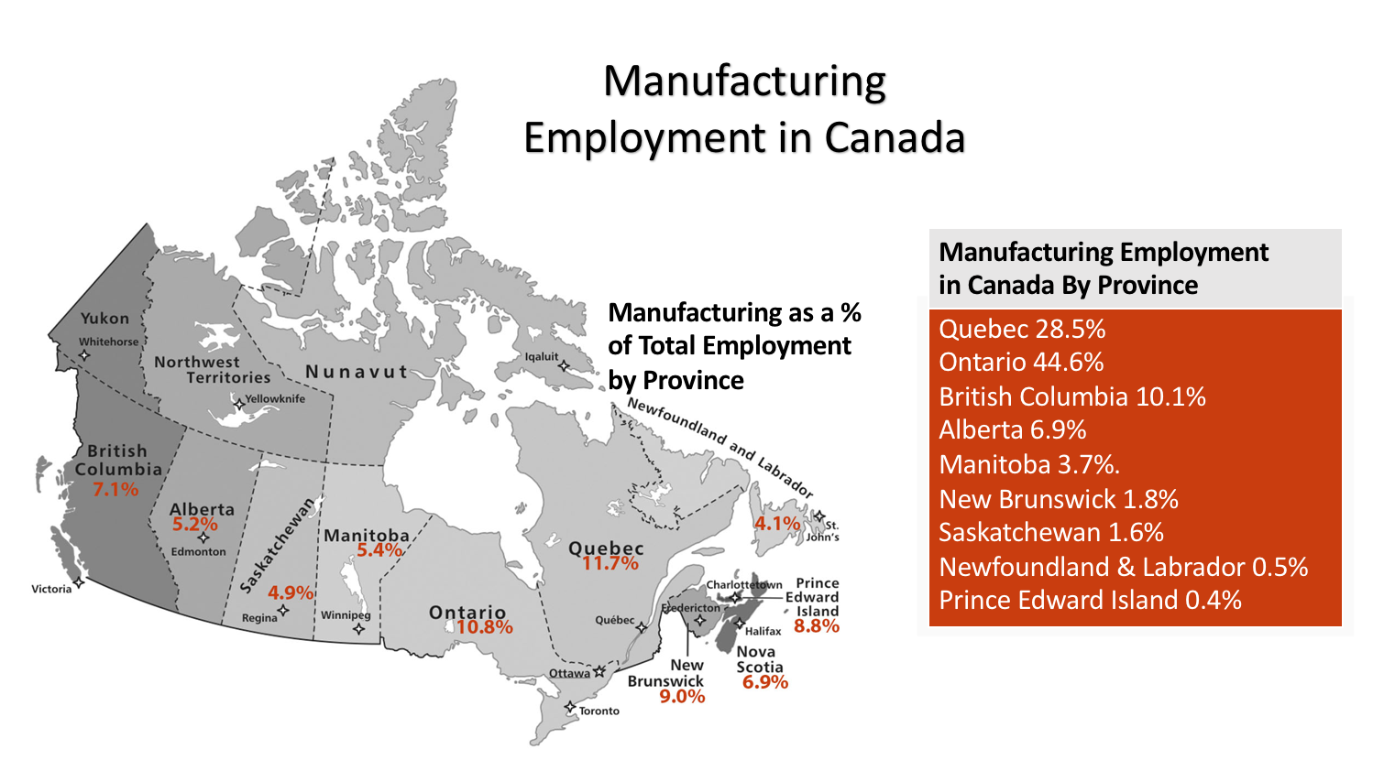
Input & Output
Detailed Job Information
Employment Tendency
Employment Map

Slide 6
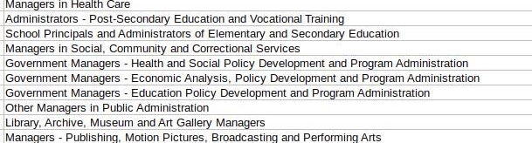
Algorithm
Substring Search
Divide jobs in the data set into several categories
Brute force, KMP, Rabin-Karp...
Find the distance between two points
Google Map API

Slide 7
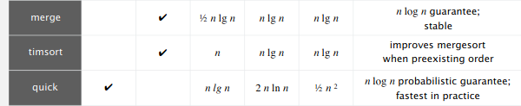
Algorithm
Sorting algorithm
Sort jobs with respect to distance from the user
Merge sort? Quick sort?

Slide 8
Reference
Government Of Canada / Gouvernement Du Canada (2020, Jan 30). Job Bank. Retrieved
from https://www.jobbank.gc.ca
Indeed: Indeed.com. Retrieved from
https://ca.indeed.com/
Robert Sedgewick, and Kevin Wayne, Algorithms, Boston,MA: Pearson, 2011.
Canada Statics. (2018, January 5). The importance of Canadian Manufacturing. The importance of Canadian Manufacturing. Retrieved from https://intelligenceindustrielle.com/en/2018/07/04/canadian-manufacturing-employment/
© 2020 GTI Media Sdn. Bhd. (298451-A) . (n.d.). Retrieved from https://gradmalaysia.com/graduate-careers-advice/planning-your-job-search/the-hunt-is-on-job-search-strategies

